Slide 1
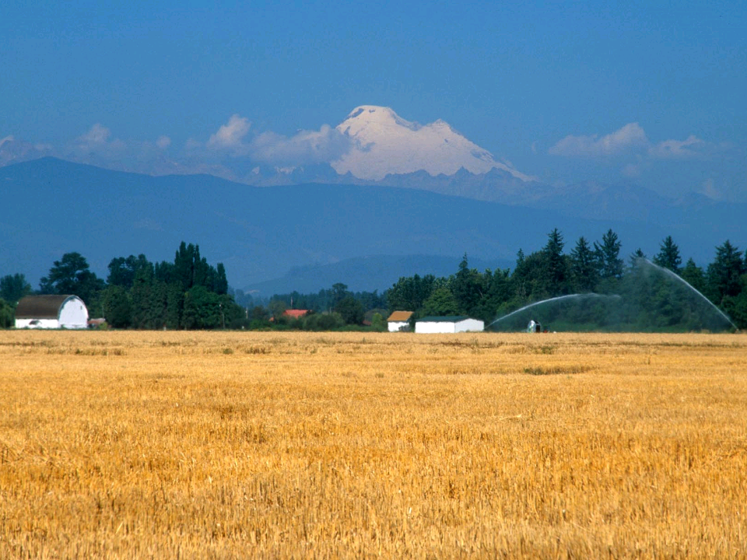

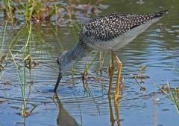
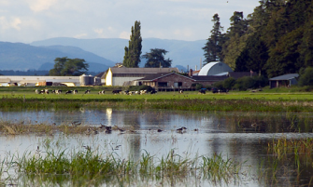
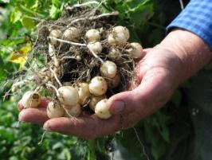
FARMING FOR WILDLIFE
Creating shorebird habitat on working farms
Julie Morse, Roger Fuller, Kevin Morse, The Nature Conservancy
Jane Lange, University of Washington
Notes:
Thanks for sticking around until the very bitter end. At the last shorebird conference I gave an introduction to an innovative project The Nature Conservancy and partners are working on in Western Washington, called Farming for Wildlife. Today, I want to present results from that research but spend most of the time talking about how that project has expanded and has really influenced The Conservancy’s working lands conservation strategy. I am excited to share how shorebirds – not salmon - how really become the poster child for a new kind of collaborative effort between farmers and conservationists.
Since I get the red lantern priveledge here… I thought I’d start with a video - to remind us why we’re all here in the first place. This video was shot last Nov, just S of here – on the Samish river delta in WA. It was on a farm participating in the FfW project – so the Nature Conservancy and partners had essentially paid this farmer to put water on his field to create a wetland.

Slide 2


Slide 3
Today, 40% of world’s terrestrial regions is agricultural lands.
With 7 billion people, and more on the way, how will global food production keep pace?
Biggest Threat or Opportunity?
Notes:
I’m sure you heard some of these statistics in Khara’s session yesterday on shorebirds in ag lands. If we’re interested in conservation of global species, we can’t ignore the scope of conversion to agricultural lands. Essentially, agriculture is now the largest biome on the planet, with 40% of world’s terrestrial lands in some form of agriculture.
What’s more, somehow agriculture needs to keep pace with human population growth. Few believe that we can actually keep pace simply by increasing yields. So this 40% is predicted to increase, dramatically.
Birdlife International already ranks habitat conversion to agriculture as one of the greatest threats to bird conservation. While habitat loss is only one threat facing shorebirds, I think it may be one of our best opportunities to address any of the confounding threats.
To demonstrate that opportunity…let me show a short video from a farm we manage just South of here in the Skagit river delta, this video was taken last winter…

Slide 4
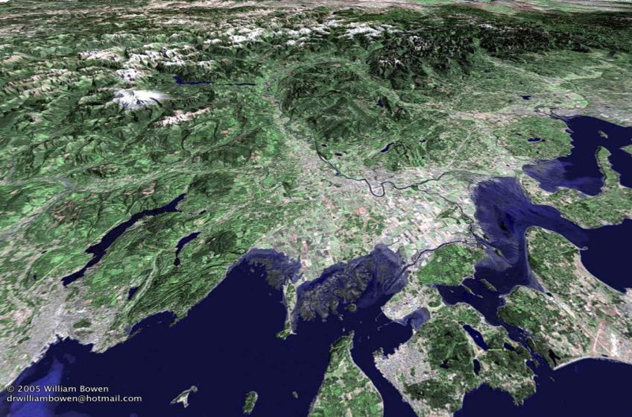
Skagit River Delta - Balancing agriculture and habitat needs of coastal species
Notes:
So here, essentially in the Frasier River, we are just off the bottom corner of this map, we’re the next major drainage N of here. So this is looking South to the Skagit and Stillaguamish river deltas – maybe not quite as popular as the Frasier as a stopover site, but we get over 30,000 shorebirds during spring and fall migrations. This is the landscape we work in, the floodplain is the nexxus for conservation and ag, it’s an incredibly productive region. Over 80 crops of commercial significance are grown here. It’s an important stopover site on the Pacific Flyway. So our challenge is to meet
70% of freshwater wetlands, and 90% of estuarine wetlands have been lost in this delta, mostly to agricultural conversion.
Most of this land base is in private ownership, and it’s not for sale.

Slide 5
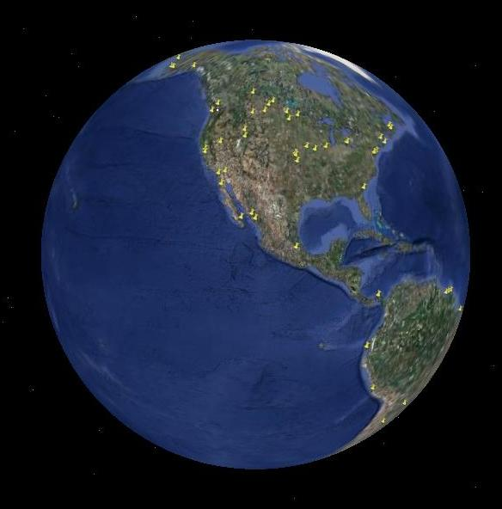
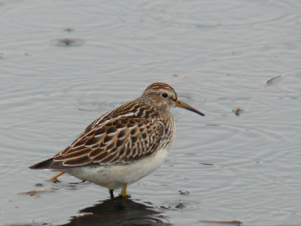
Shorebird Conservation – Stopover Sites on the Pacific Flyway
Pectoral Sandpiper on a rest break at a Farming for Wildlife site in the Skagit Valley
Notes:
the issues we face in the Skagit Delta are similar in coastal ag lands worldwide. Particularly on the Pacific flyway – our coastal regions are dominated by ag. And certainly this crowd understands the importance of stopover sites during long distance migrations.

Slide 6
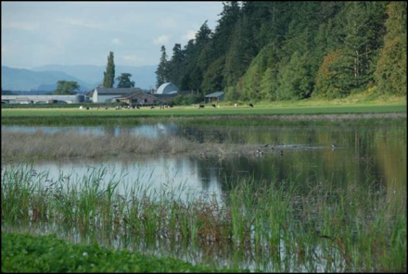
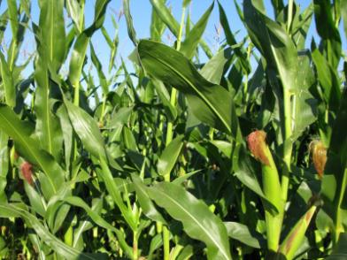
Farming for Wildlife Goals
Enhance habitat value of working lands, without taking farmland out of production
Develop alternative land use practices, and provide incentives
Develop a model for habitat rotations that makes sense - economics, agronomics, and ecologically
Notes:
Goals – first and foremost trying to understand a way to restore wetland habitat without taking farmland permanently out of production. Given the scale of agriculture today that I mentioned earlier, we can’t affect conservation on a meaningful scale without addressing conservation on private lands. From The Nature Conservancy’s standpoint, we are interested in creating habitat for shorebirds whose populations are in decline. They use these wetlands to stop and rest and eat during fall and spring migrations along the pacific flyway. We want this to be a win-win project so trying to understand ways that farmers could benefit as well. Has to work economically (probably most importantly), has to work agronomically, and needs to work ecologically

Slide 7
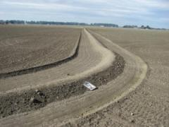
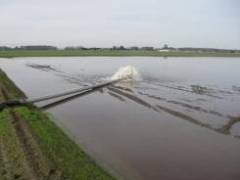
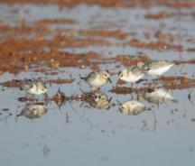
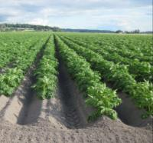
Farming 101 - Crop rotations
Geographic / crop specific rotation practices
In the Skagit, 2 years rotations are common, but range 1 - 13 years
Rotation practices - control specific diseases or improve soil fertility
Rotation crops are generally not cash crops
What is a wetland rotation?
1. Build berms
2. Flood
3. Manage
4. Back to farming

Slide 8
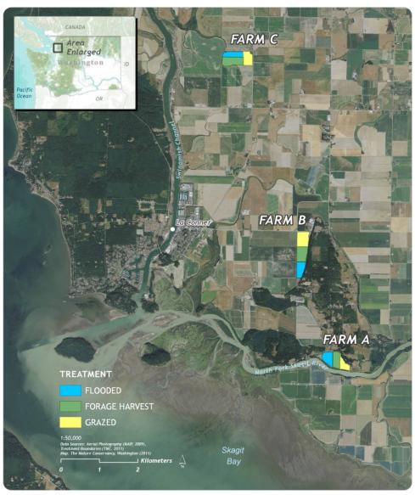
Farming for Wildlife Pilot Project
Compared Wetland, Forage Harvest, and Grazing rotations
Monitored Shorebird use during fall and spring migrations, and winter
2006 - 2009

Slide 9
Pilot Project – Shorebird use of 3 different crop rotations
Notes:
The results were promising, tho - as with any 2 year shorebird study, certainly not conclusive. The furthest left column is baseline data - when all the fields were planted the same to a simple cover crop, and we had very little shorebird use across the board. The first year that we implemented the wetland treatment

Slide 10
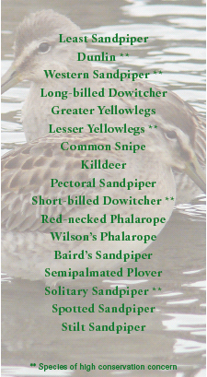
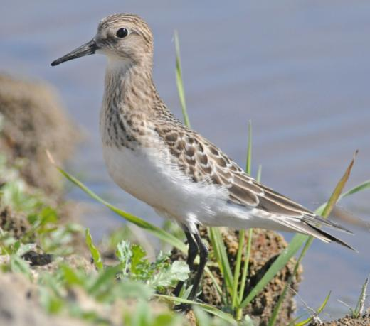
Species Diversity – high on wetland rotations
Baird Sandpiper @ Roozen’s farm Fall 2009
Notes:
We looked at 2 shorebird metrics – abundance and diversity. Not surprisingly we had far greater diversity of species on the wetland rotation than other rotations, including some relatively rare species in our area.

Slide 11
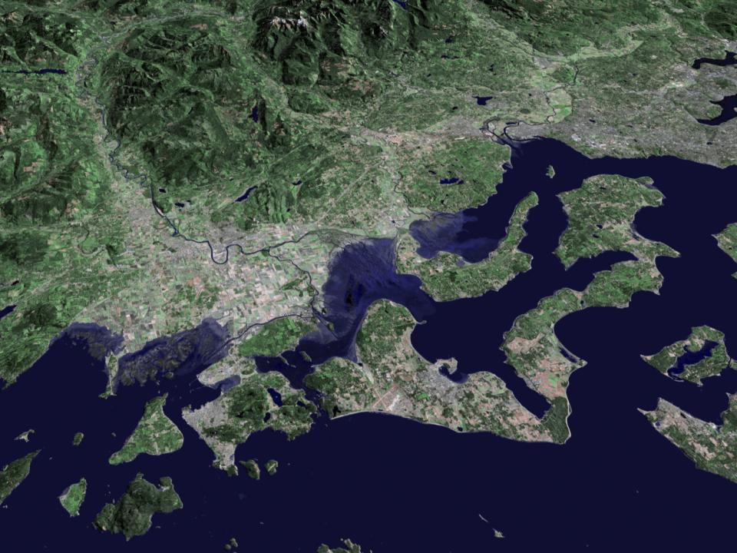
Project Sites – building a shifting mosaic of ephemeral wetlands
150 acres flooded to date
Ellingson
Morrison
Waltner
Roozen
Schmidt
Mesman
Thein
Hedlin
Thulen
Soltes
Pilot Study Sites (57 acres) 2006-2009
WHIP Trial Sites (37 acres) 2009-2010
WSU Pathogen Research sites (10 acres) 2010
NRCS Conservation Innovation Grant Sites – Currently Flooded (66 acres) 2010-2012
Notes:
So this is a small scale proof of concept project at this point. To date, we’ve flooded ~ 150 acres. The dark blue sites were flooded during the pilot study , and are now back in production. The farmers were happy with yields off these sites following the wetland rotation, despite it also being a very wet and cold growing season. The yellow sites are currently flooded, the video was from this site here. The idea here, is to create a create mass of habitat on the landscape. the cool thing about working with migratory birds – is the habitat doesn’t have to be tied to a specific spot on the landscape, it can move. This process is also serving to build a market for wetland rotations, by engaging more farmers.

Slide 12



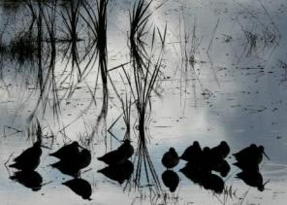
Partnerships
Natural Resources Conservation Service
Washington State University
Western Washington Agricultural Association
Skagitonians to Preserve Farmland
Ecostudies Institute
Funding
NRCS – Conservation Innovation Grant
Washington Conservation Commission
EPA
National Fish and Wildlife Foundation
Packard Foundation
Private Donors
Notes:
As you may have noticed on the last slide this is very much a collaborative effort. The agricultural community, university, government agencies, and nonprofit agencies are all very involved in this project. Skagit farmers were very involved in establishing intial case study, wsu now very involved in our research objectives. Additionally, the project has been very successful in leveraging both private and public funds. In addition to the ag pilot grant, this work has been supported by grants from the EPA, NFWF, the Packard foundation, and generous private donors.

Slide 13
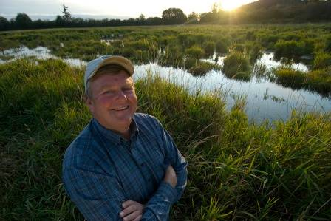
“If 100 years from now there are fish, farms, and shorebirds in this valley, then everybody wins”
Farmer Dave

Slide 14
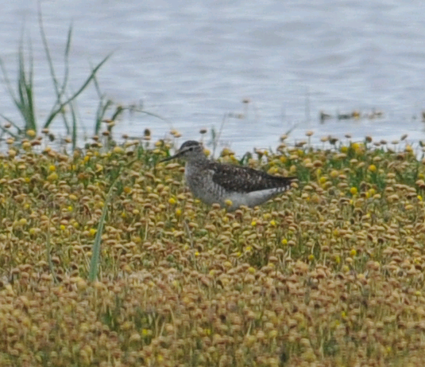
Parting Shot from the Soltes farm last week…..
Questions? Please contact: jmorse@tnc.org

